Slide 1
Predicting Malicious and Benign Webpages

Slide 2
HELLO!

Slide 3
Project Overview

Slide 4
Overview
One of the biggest challenging on the internet now is web Security; there are billions of websites active on Internet, So threats on the Internet is increasing and the hackers evolving newer techniques to trap web users. But With the advancement of technology, especially in the field of AI and ML, we can detect malicious webpages by using machine learning.

Slide 5
Goal
the Goal of my project is to build a classification ML model that can detect these attacks based on previous attacks happened to many webpages.
The Benefits of building such this model is to help organization in improving their security on premises
used by Cyber Security firms or Anti-Virus companies to model their security products
Also, the result of the model can be used by Cyber Law Enforcement to enhance their policy procedure.

Slide 6
Data Description

Slide 7
Data Description
Data was gathered from Web between November 2019 and March 2020, with random web crawls carried out to ensure adequate global coverage.
The dataset was designed and prepared with the aim of classification of webpages as Malicious or Benign. However, related to webpage analysis. The attributes of this dataset are listed
The dataset contains sufficient information that can be used for any machine learning task

Slide 8
Data Description cont,
The Dataset containing 10,000 Webpages with 9 features.
Features of the Dataset are both categorical and numerical types
The last attribute is Class Label, which can be used for training the machine learning algorithm.
The two classes correspond to Malicious (bad) and Benign (Good) webpages.

Slide 9
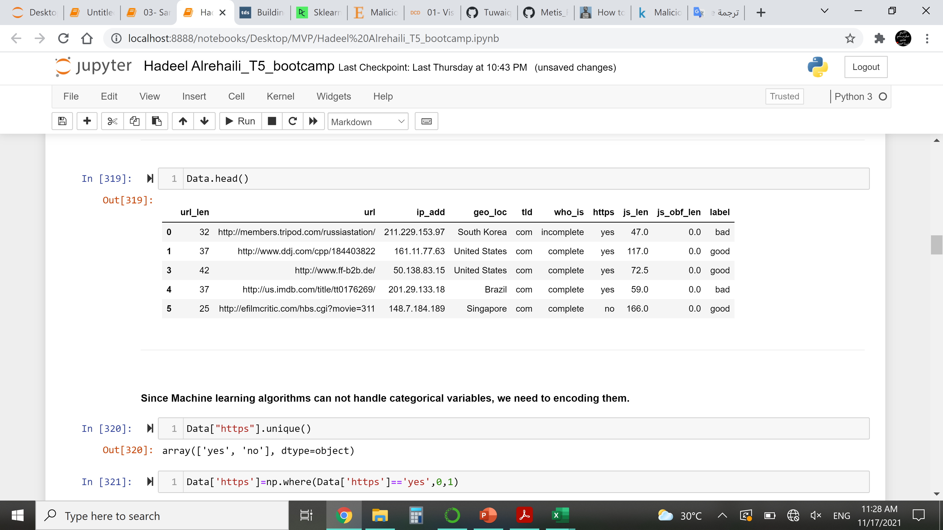
Snapshot of the Dataset
Target
Notes:
First attribute of the dataset represents URL of the webpages. Visualization of ‘url’ attribute, after vectorizing it (using Profanity Score³), is depicted in Fig. 3. The second attribute ‘ip_add’ gives the IP Address of the Webserver hosting the webpage. Third attribute ‘geo_loc’ gives the country to which the IP Address belongs. The IP Address distribution is plotted country wise in Fig. 4 and Fig. 5 for Malicious and Benign webpages, respectively. As can be inferred from the maps in Fig. 4 and Fig. 5, the dataset represents webpages from servers across the globe.

Slide 10
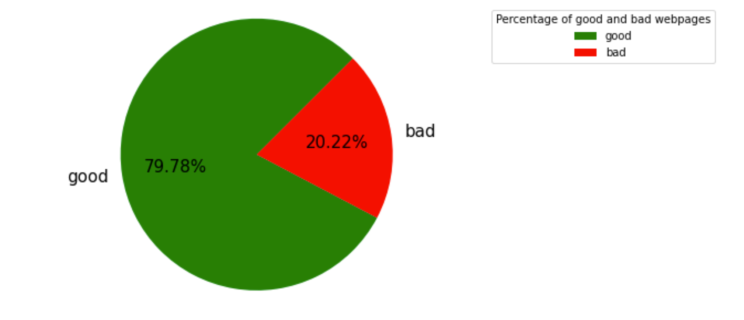
Class label distribution - Malicious & Benign
Notes:
The two classes correspond to Malicious and Benign webpages. As the Internet has more Benign pages than Malicious² webpages, a similar disproportion also reflects in our Dataset. As seen in the graphical representation of Class Labels in Fig. 2, a majority of the webpages are benign. Thus, users of this dataset should appropriately factor this skew in class distribution while training machine learning models.

Slide 11
RandomUnderSampler
Random over-sampling
Generate new samples by randomly sampling with replacement of the currently available samples
Original dataset shape Counter({'bad': 7821, 'good’: 2020)
Resample dataset shape Counter({'bad': 7821, 'good': 7821})
Notes:
RandomUnderSampler is a fast and easy way to balance the data by randomly selecting a subset of data for the targeted classes. Under-sample the majority class(es) by randomly picking samples with or without replacement.
techniques used to adjust the class distribution of a data s

Slide 12
Feature Extraction & Cleaning
Imputing or dropping missing values
Handling Outliers
Encoding categorical data
Notes:
After a Data understanding I begin to work on data cleansing and cleaning
To prepare my dataset to training

Slide 13
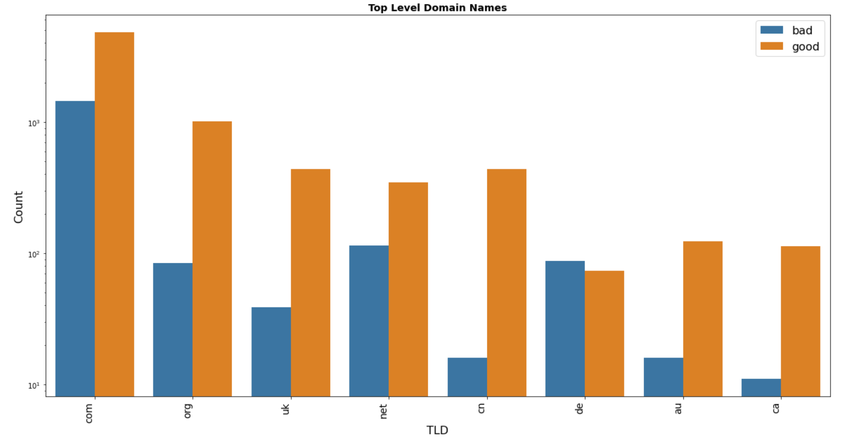
EDA with histogram
‘TLD’ gives the Top-Level Domain Name of the webpage
Notes:
One of the EDA I do is I histogram on attribute TLD
In this graph I select the most frequent TLD and plot it with labeled webpages..to see witch domain have the most bad pages

Slide 14
Algorithms
Logistic regression
Random Forest
Accuracy : 0.96
Accuracy : 0.97

Slide 15
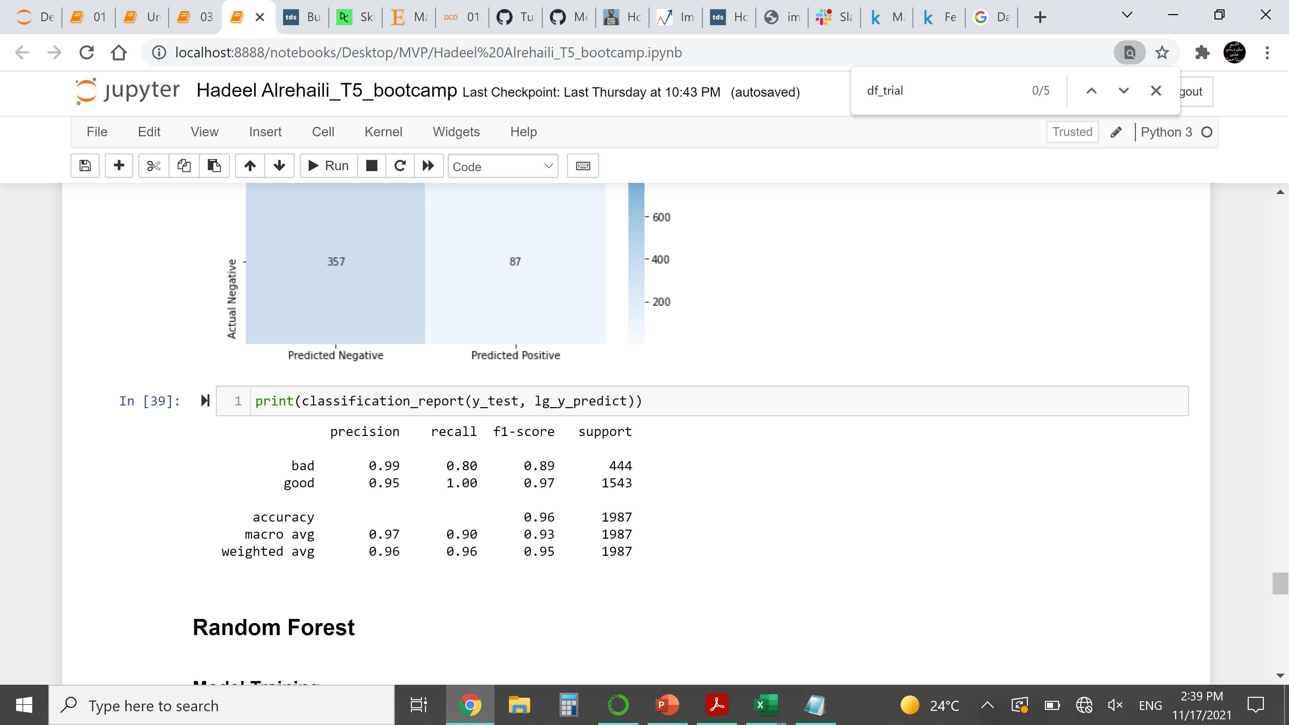
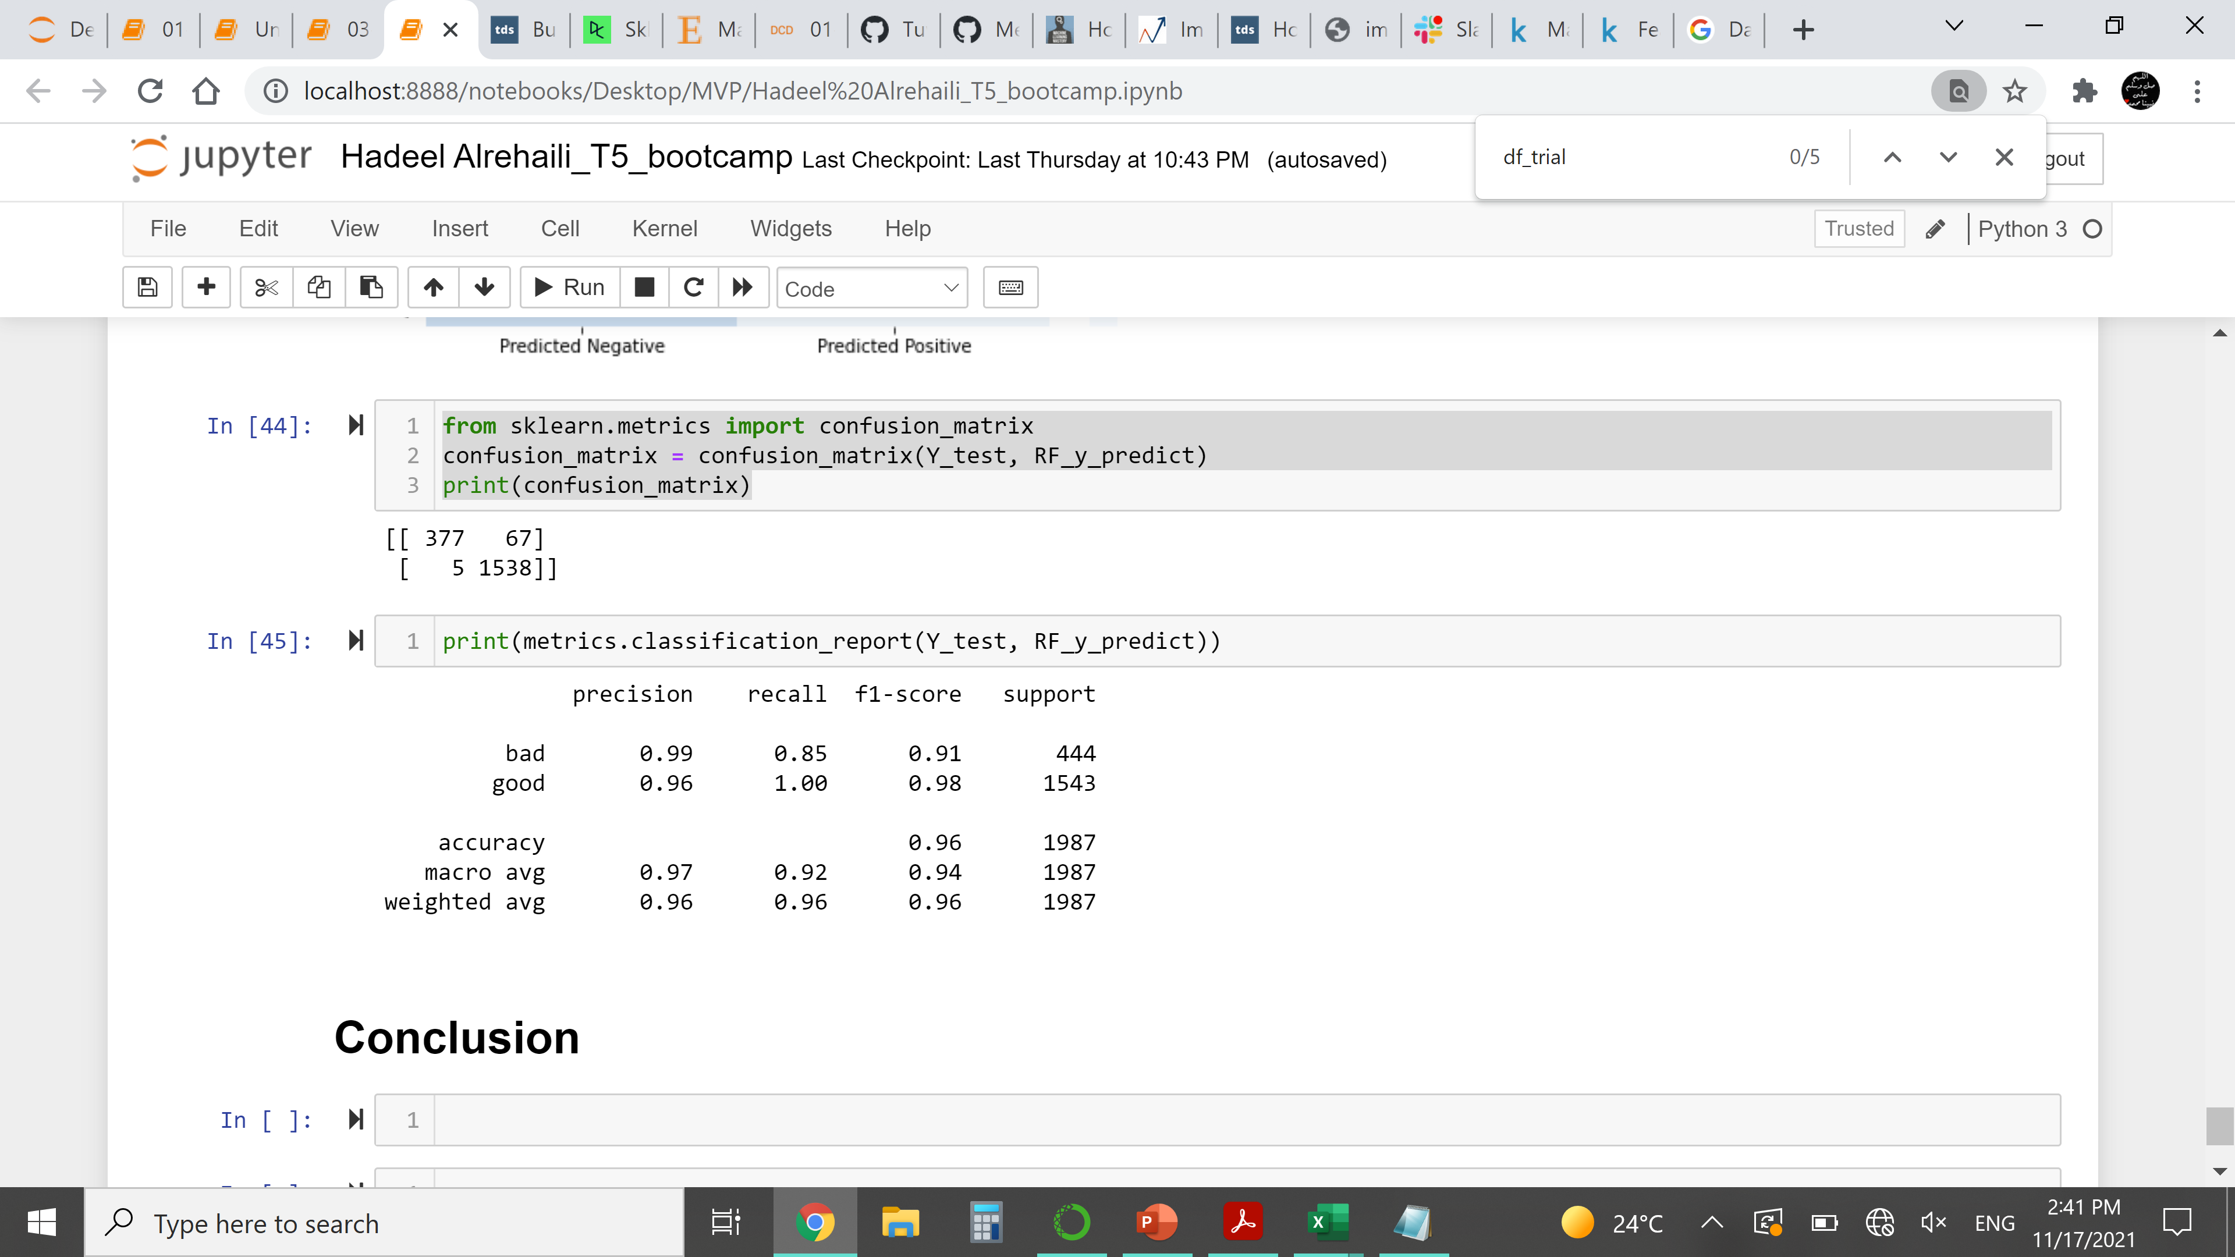
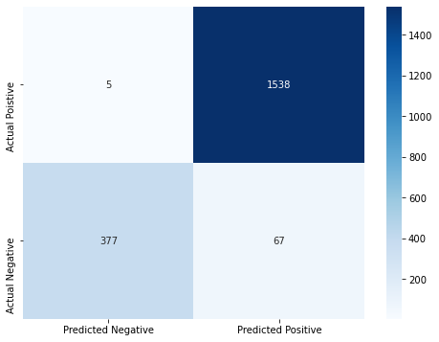

Model Evaluation
Random Forest
Logistic regression

Slide 16
THANK you

